Slide 1
Computer Graphics:
Scan Conversion Algorithms
Line Drawing Algorithm - DDA

Slide 2
Scan Conversion
A line segment in a scene is defined by the coordinate positions of the line end-points
y
(7, 5)
(2, 2)
x

Slide 3
The Problem Of Scan Conversion
But what happens when we try to draw this on a pixel based display?
How do we choose which pixels to turn on?

Slide 4
Considerations
Considerations to keep in mind:
The line has to look good
Avoid jaggies
It has to be lightening fast!
How many lines need to be drawn in a typical scene?
This is going to come back to bite us again and again

Slide 5
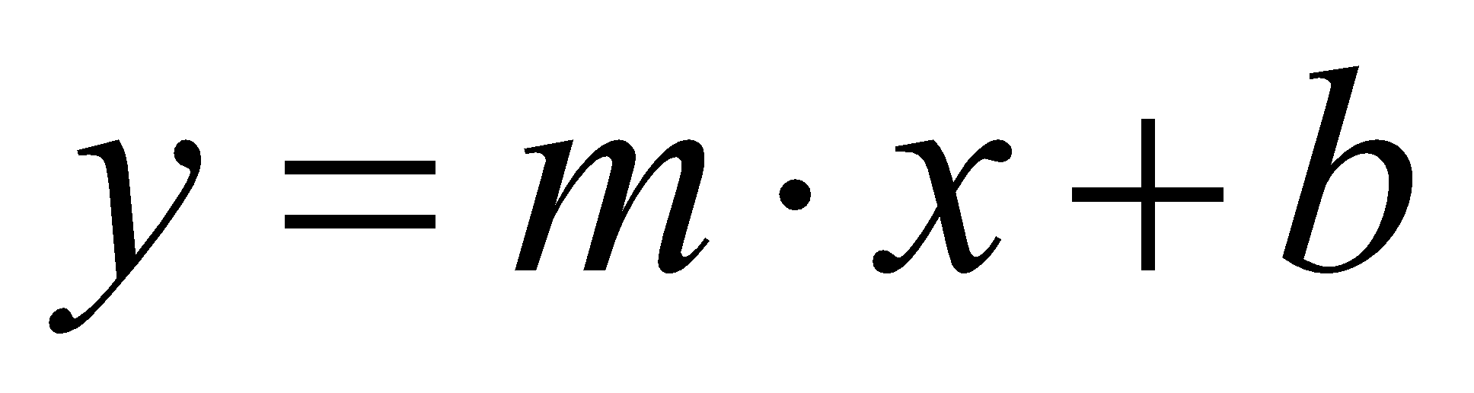
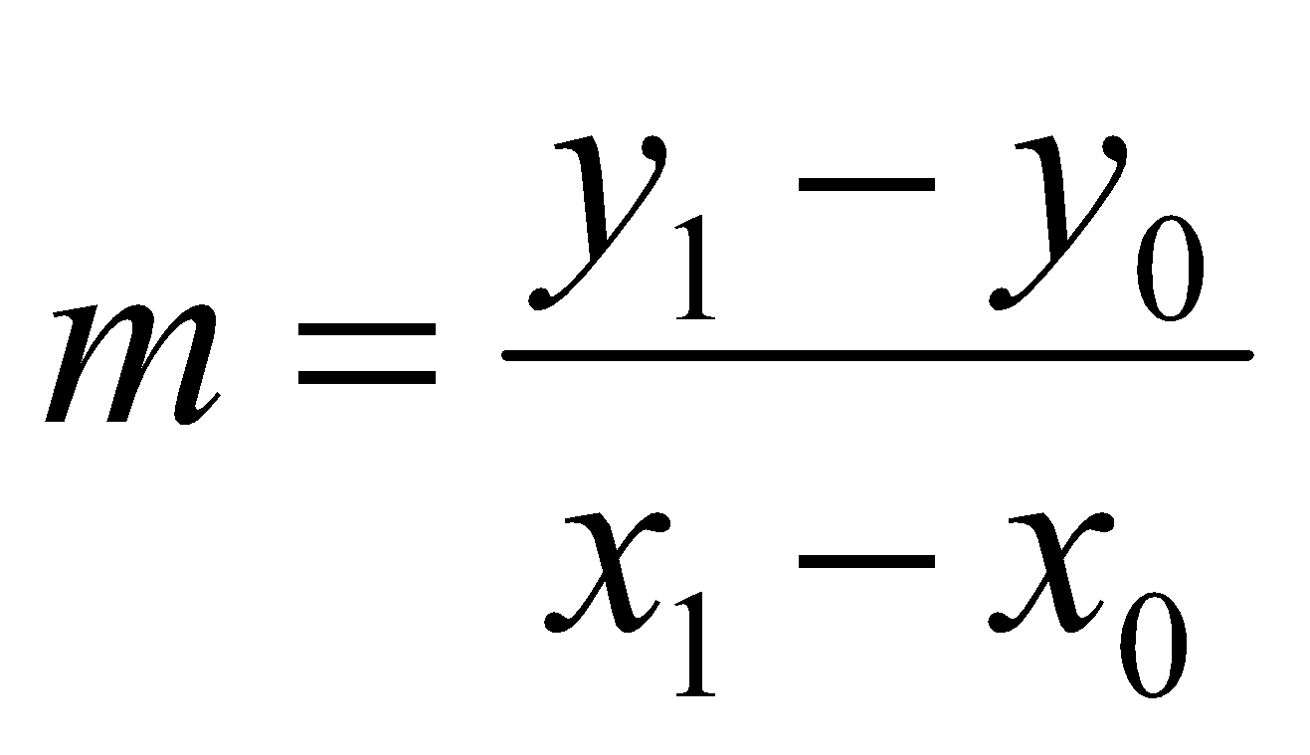
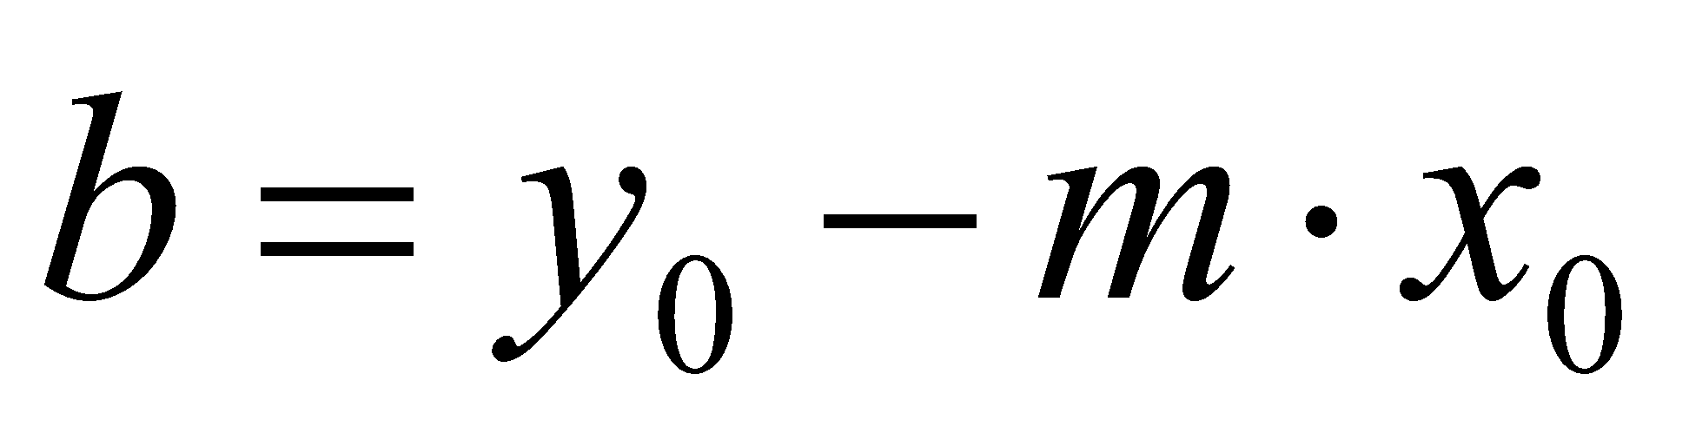
Line Equations
Let’s quickly review the equations involved in drawing lines
Slope-intercept line equation:
y
y₁
where:
y₀
x₀
x₁
x

Slide 6
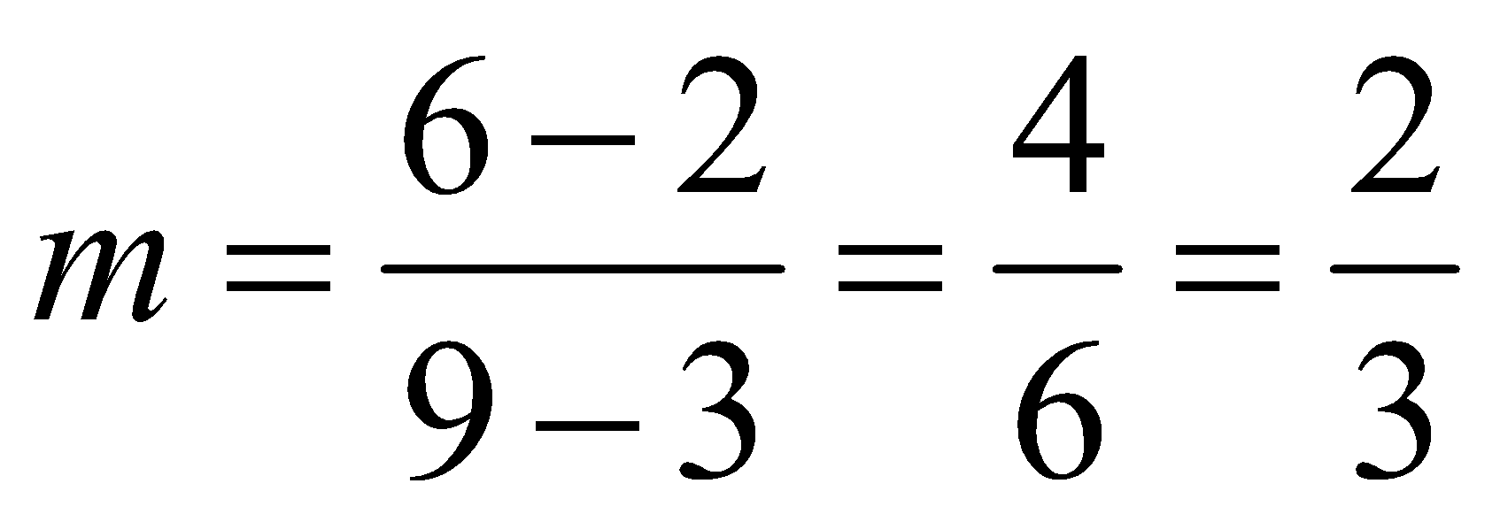
Line Equations
Let’s quickly review the equations involved in drawing lines
Slope-intercept line equation:
y
(9, 6)
y₁
where:
y₀
(3, 2)
x₀
x₁
x
b = 2 - (⅔).3 = 2 - 2 = 0

Slide 7
A Very Simple Solution
We could simply work out the corresponding y coordinate for each unit x coordinate
Let’s consider the following example:
y
(7, 5)
5
2
(2, 2)
2
7
x

Slide 8
A Very Simple Solution (cont…)
5
4
3
2
1
0
0
1
2
3
4
5
6
7

Slide 9
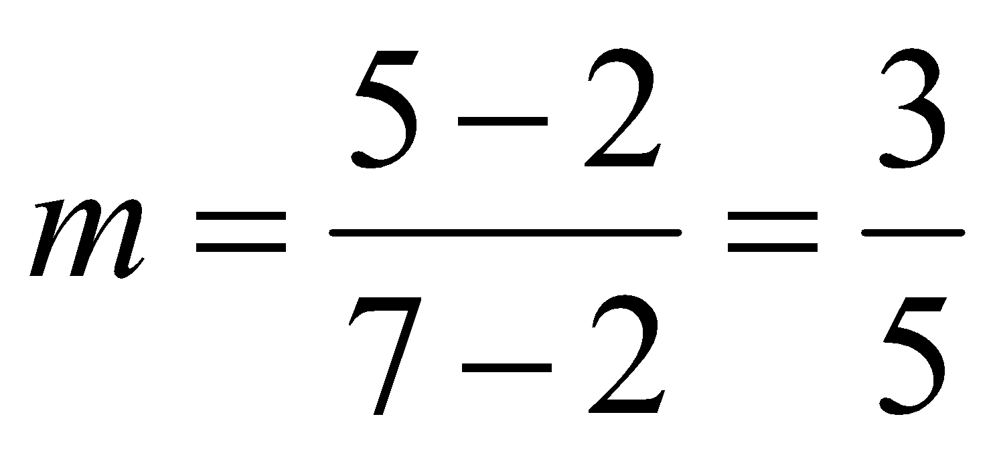
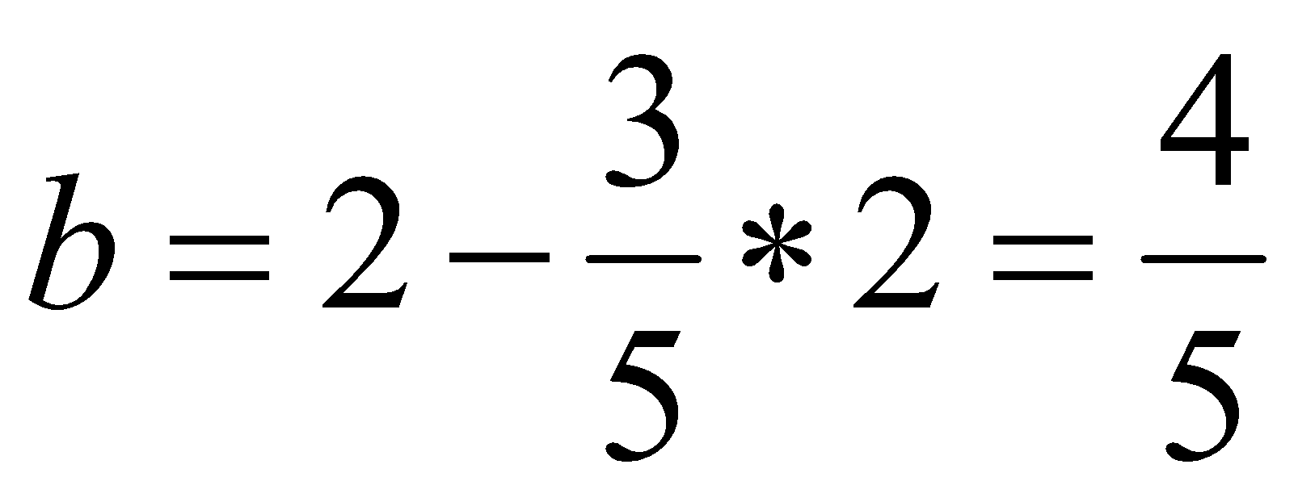
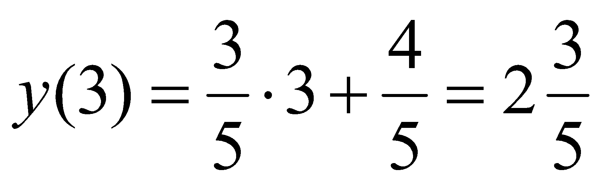
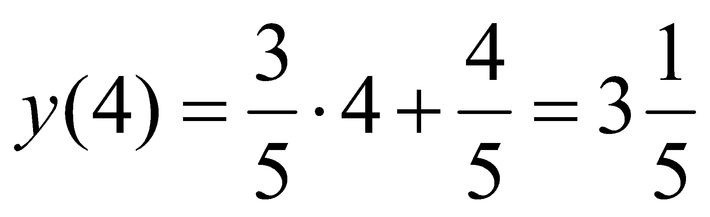
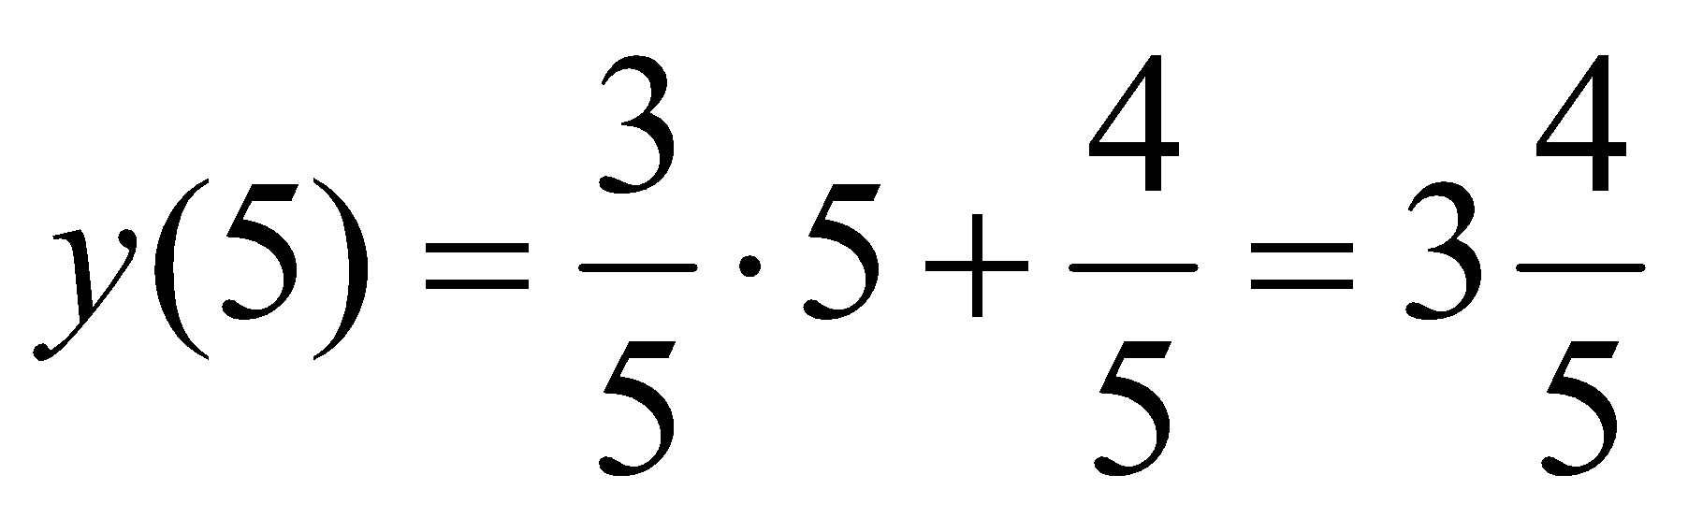
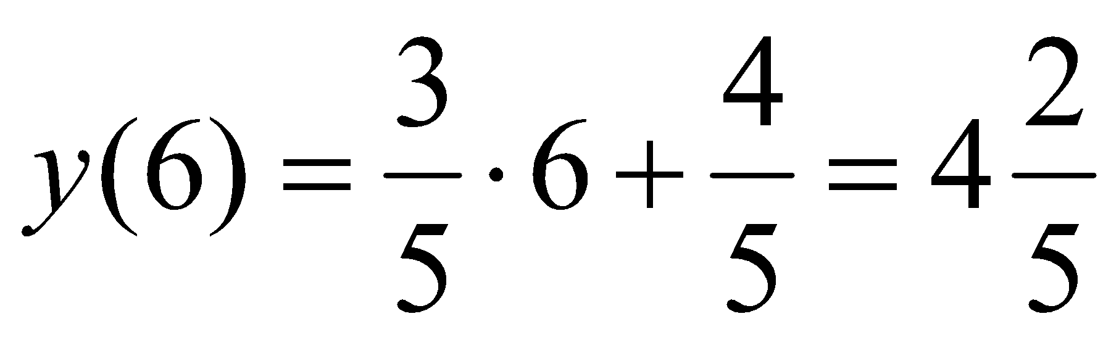
A Very Simple Solution (cont…)
y
First work out m and b:
(7, 5)
5
2
(2, 2)
2
3
4
5
6
7
x
Now for each x value work out the y value:

Slide 10
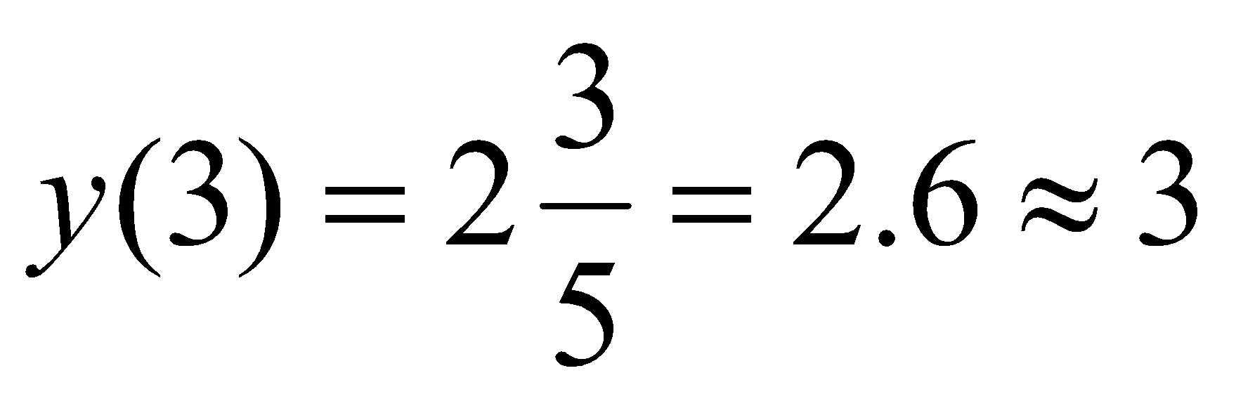
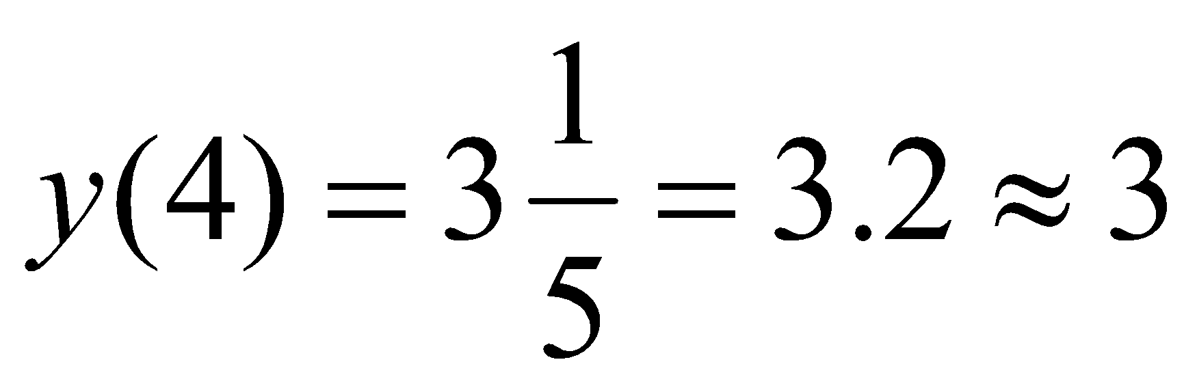
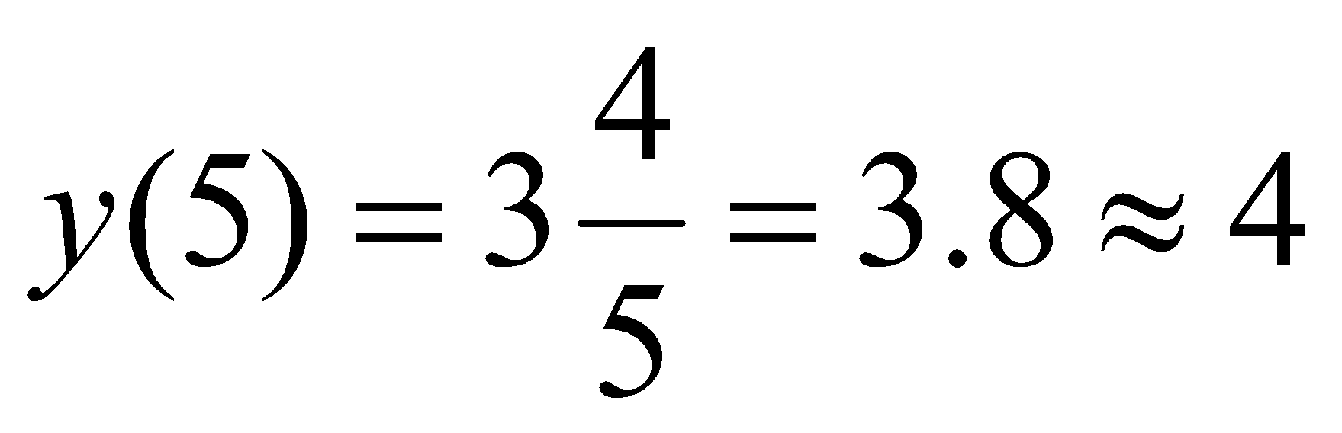
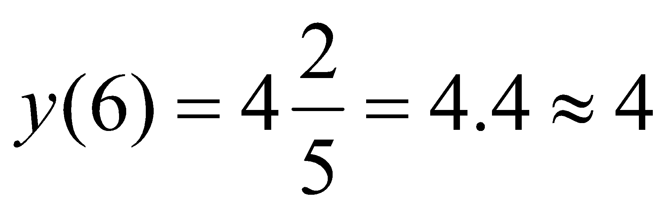
A Very Simple Solution (cont…)
Now just round off the results and turn on these pixels to draw our line
Pixel
(3, 3)
(4,3)
(5,4)
(6,4)
7
6
5
4
3
2
1
0
0
1
2
3
4
5
6
7
8

Slide 11
A Very Simple Solution (cont…)
However, this approach is just way too slow
In particular look out for:
The equation y = mx + b requires the multiplication of m by x
Rounding off the resulting y coordinates
We need a faster solution

Slide 12
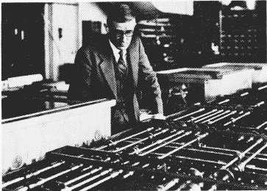
The DDA Algorithm
The digital differential analyzer (DDA) algorithm takes an incremental approach in order to speed up scan conversion
Simply calculate y_{k+1} based on y_{k}
The original differential analyzer was a physical machine developed by Vannevar Bush at MIT in the 1930’s in order to solve ordinary differential equations.

Slide 13
The DDA Algorithm (cont…)
Consider the list of points that we determined for the line in our previous example:
(2, 2), (3, 2³/₅), (4, 3¹/₅), (5, 3⁴/₅), (6, 4²/₅), (7, 5)
Notice that as the x coordinates go up by one, the y coordinates simply go up by the slope of the line
This is the key insight in the DDA algorithm

Slide 14
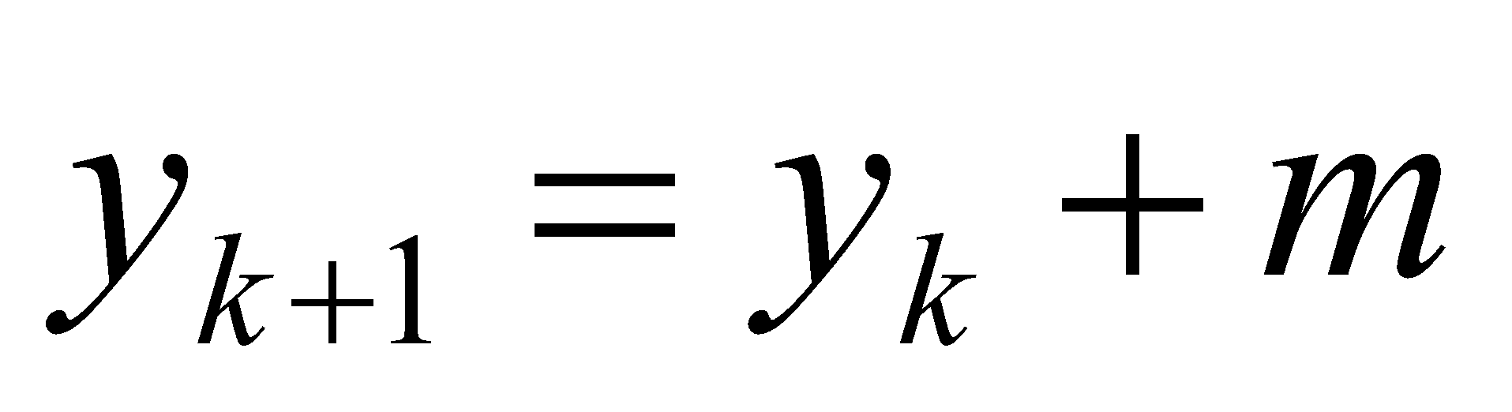
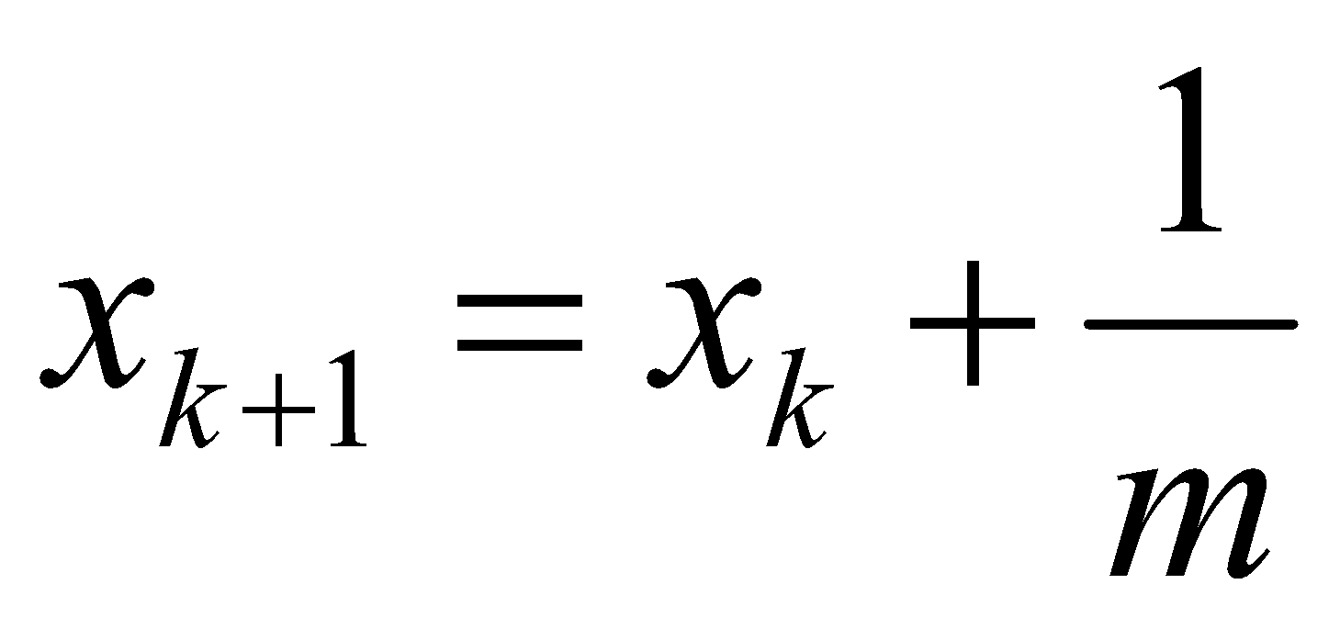
The DDA Algorithm (cont…)
When the slope of the line is between -1 and 1 begin at the first point in the line and, by incrementing the x coordinate by 1, calculate the corresponding y coordinates as follows:
When the slope is outside these limits, increment the y coordinate by 1 and calculate the corresponding x coordinates as follows:

Slide 15
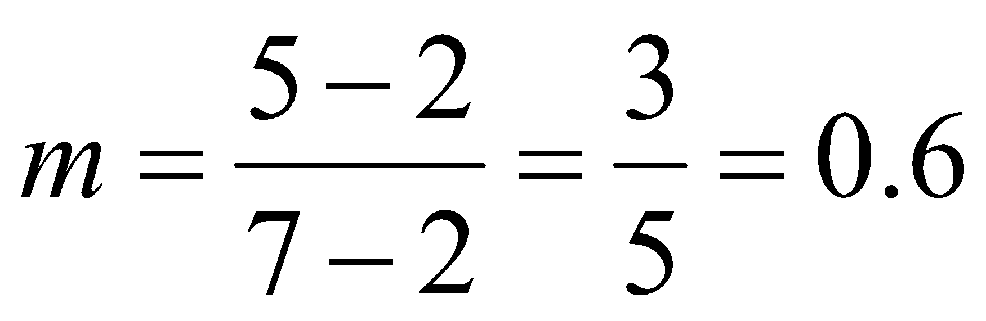
DDA Algorithm Example
Let’s try out the following examples:
y
x(+1) | y(+m) | y(roundoff) | pixel
2 | 2
3 | 2.6 | 3 | (3, 3)
4 | 3.2 | 3 | (4, 3)
5 | 3.8 | 4 | (5, 4)
6 | 4.4 | 4 | (6, 4)
(7, 5)
5
2
(2, 2)
2
7
x

Slide 16
DDA Algorithm Example (cont…)
7
6
5
4
3
2
0
1
2
3
4
5
6
7

Slide 17
The DDA Algorithm (cont…)
Again the values calculated by the equations used by the DDA algorithm must be rounded to match pixel values
(x_{k}+1, round(y_{k}+m))
(round(x_{k}+ ¹/_{m}), y_{k}+1)
(x_{k}, y_{k})
(x_{k}+ ¹/_{m}, y_{k}+1)
(x_{k}+1, y_{k}+m)
(x_{k}, y_{k})
(x_{k}, round(y_{k}))
(round(x_{k}), y_{k})

Slide 18
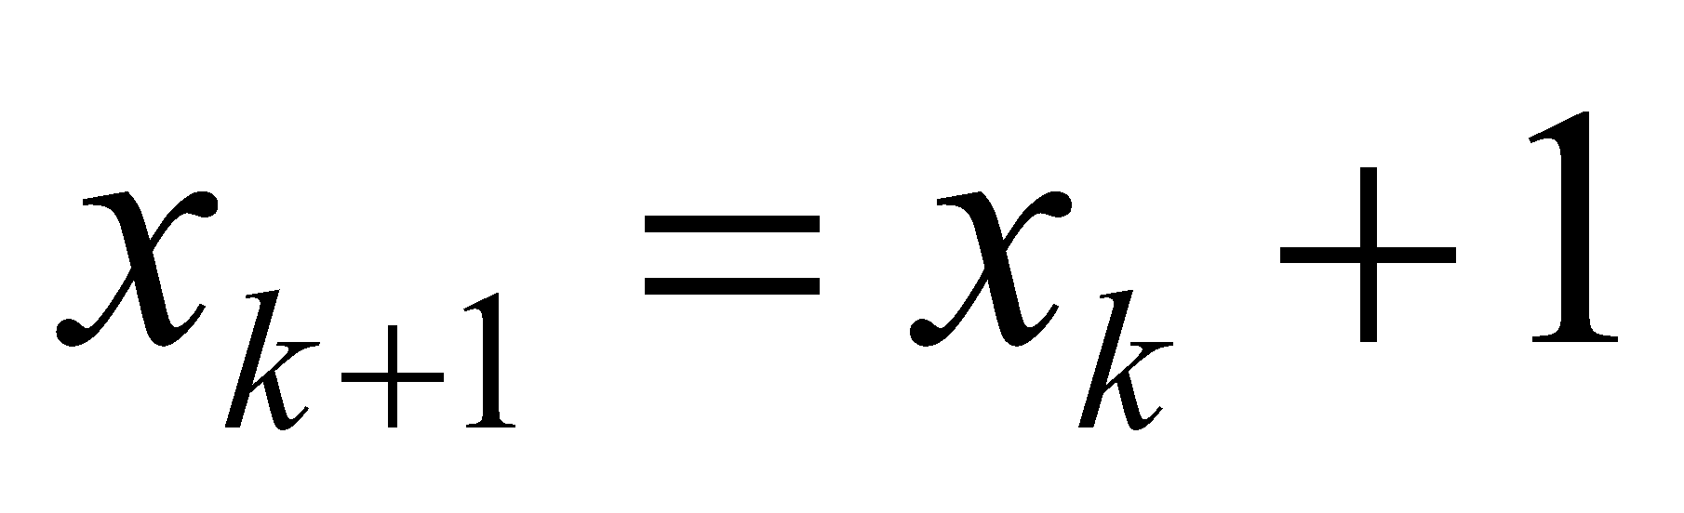
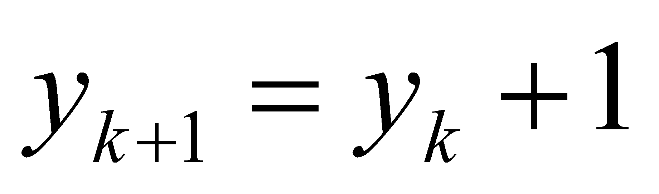
The DDA Algorithm (cont…)
If -1<m<1 then
Then roundoff y.
Otherwise,
Then roundoff x.

Slide 19
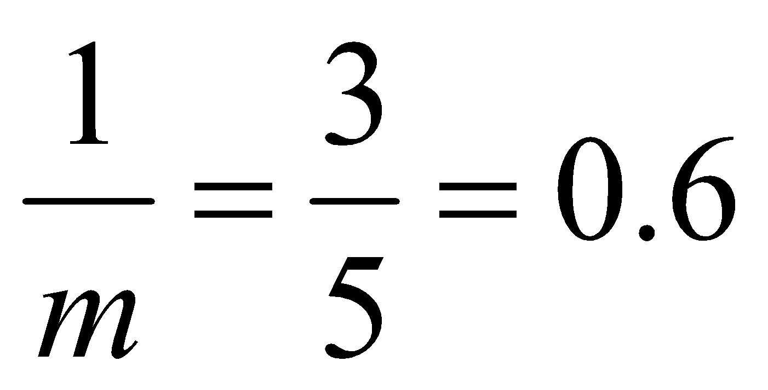
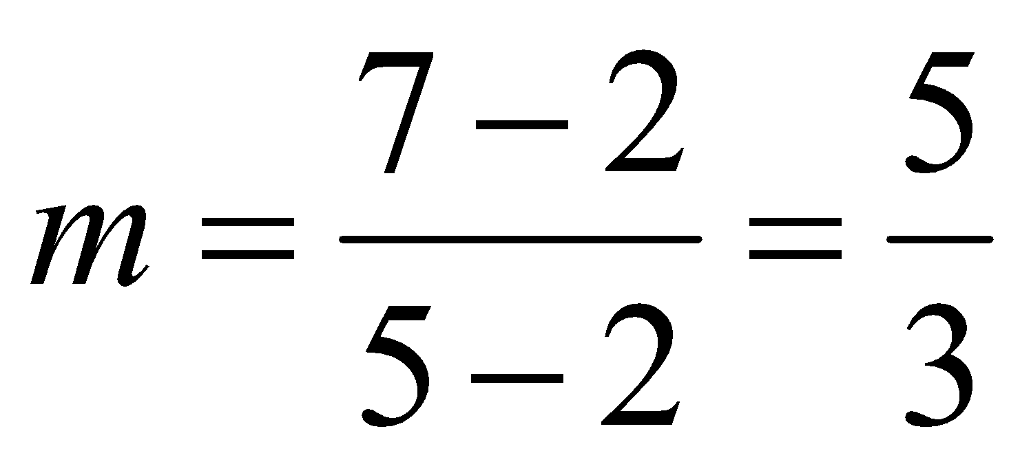
DDA Algorithm Example
Let’s try out the following examples:
y
(5, 7)
y(+1) | x(+1/m) | x(roundoff) | pixel
2 | 2
3 | 2.6 | 3 | (3, 3)
4 | 3.2 | 3 | (3, 4)
5 | 3.8 | 4 | (4, 5)
6 | 4.4 | 4 | (4, 6)
5
2
(2, 2)
2
7
x

Slide 20
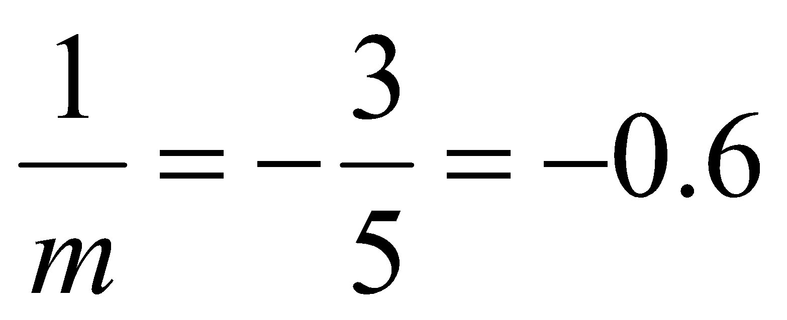
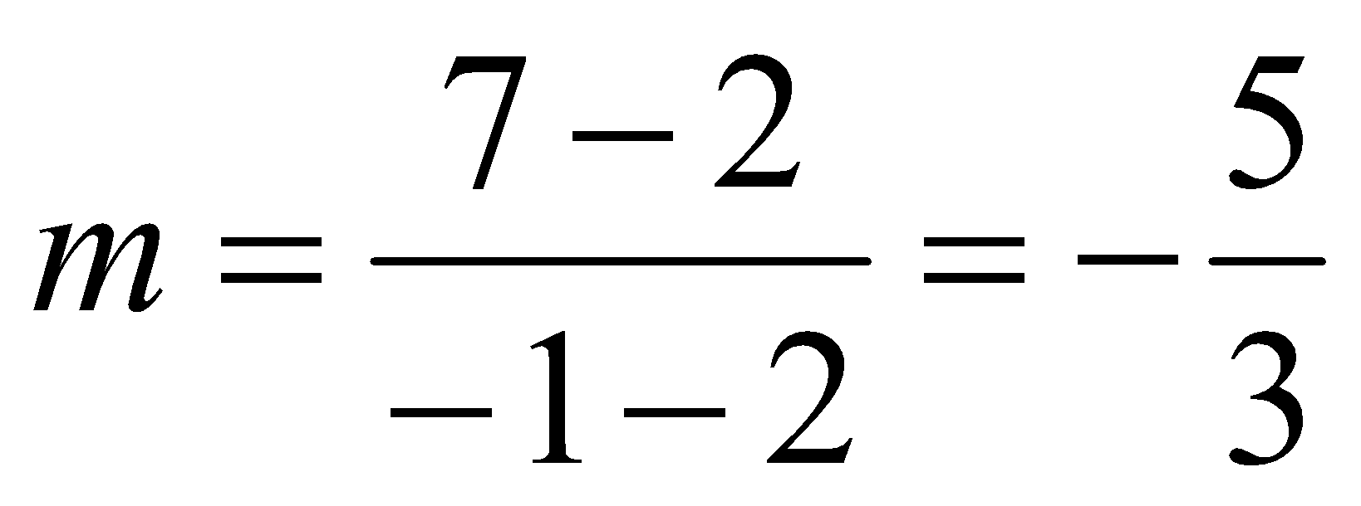
DDA Algorithm Example
Let’s try out the following examples:
y
(-1, 7)
y(+1) | x(+1/m) | x(roundoff) | pixel
2 | 2
3 | 1.4 | 1 | (1, 3)
4 | 0.8 | 1 | (1, 4)
5 | 0.2 | 0 | (0, 5)
6 | -0.4 | 0 | (0, 6)
(2, 2)
2
7
x

Slide 21
The DDA Algorithm Summary
The DDA algorithm is much faster than our previous attempt
In particular, there are no longer any multiplications involved
However, there are still two big issues:
Accumulation of round-off errors can make the pixelated line drift away from what was intended
The rounding operations and floating point arithmetic involved are time consuming

Slide 22
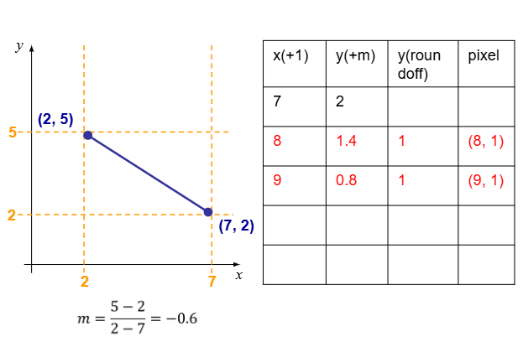
Look Closely — Can DDA solve this?

Slide 23
Look Closely — Can DDA solve this?
(8, 1), (9, 1) these points are outside the line segment, so unacceptable.
So, we must decrement here. So we need to update our DDA algorithm for these cases.

Slide 24
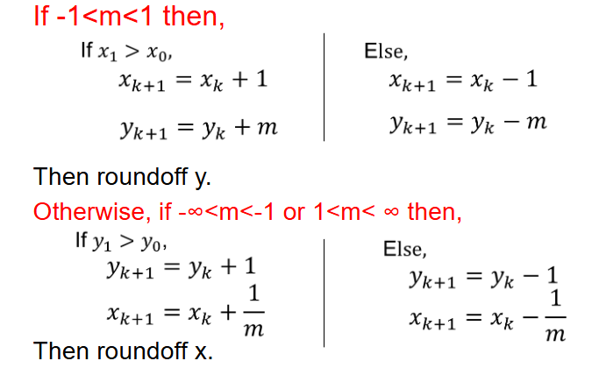
DDA Algorithm (Revised Version)

Slide 25
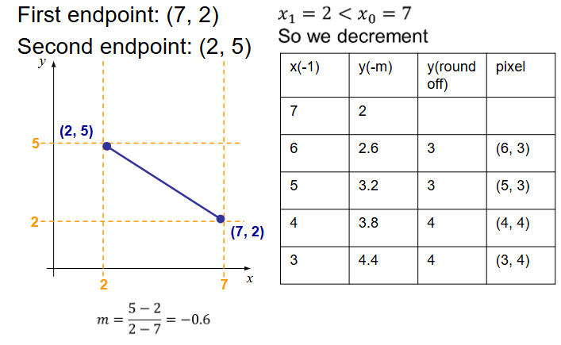
Now Run the Previous Simulation Again!

Slide 26
DDA Simulation Exercise
Using DDA algorithm find out the first 10 pixels of the lines whose endpoints are given: (Always use the Revised DDA)
(20, 5), (15, 50)
(-5, 50), (-15,0)
(-10, -10), (48, 24)
(48, 24), (-10, -10)
(-1011, -2022), (-2022, -1011)
Note: Order of endpoints can affect the conditions selected from the DDA Algorithm (Check c and d). But the pixels will be same.

